Slide 1


The
Strategic Thinkers
Birla Institute of Technology, Mesra
Round 2
Team
Yash Khandelwal
Raavee Maheshwari

Slide 2
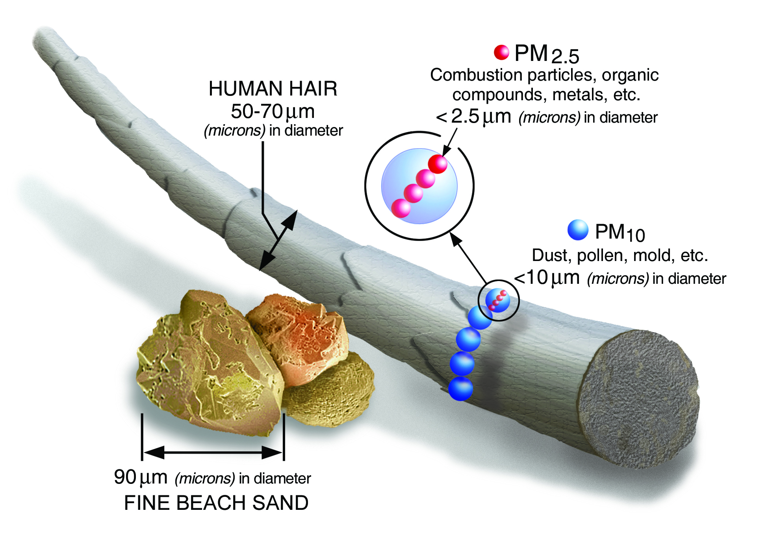
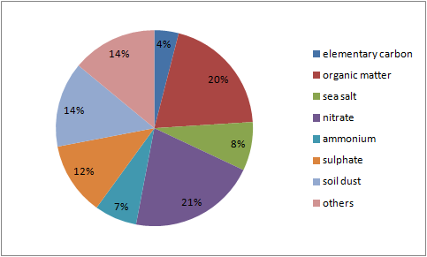
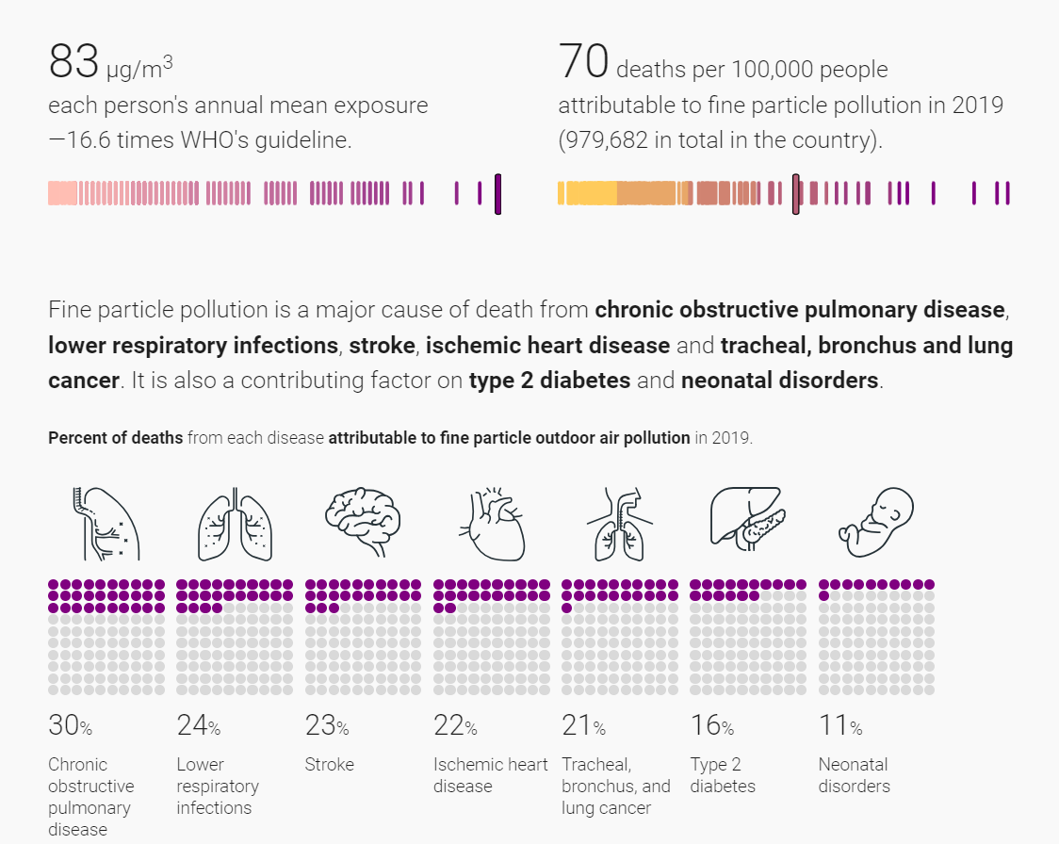
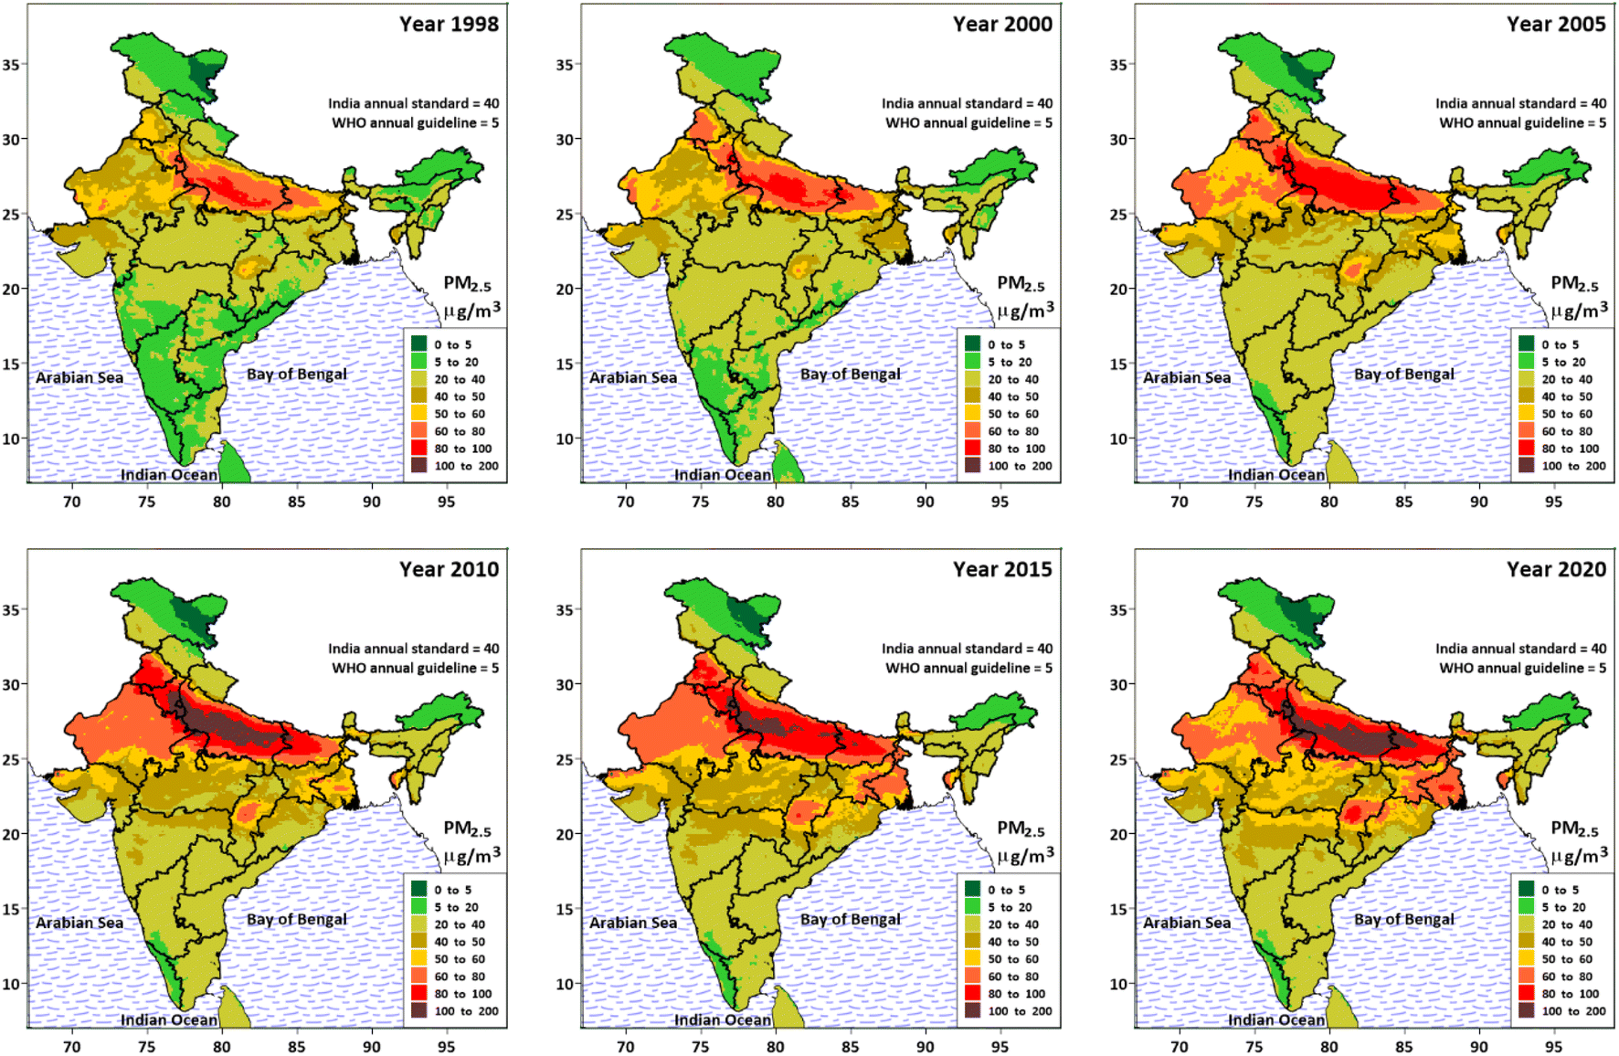
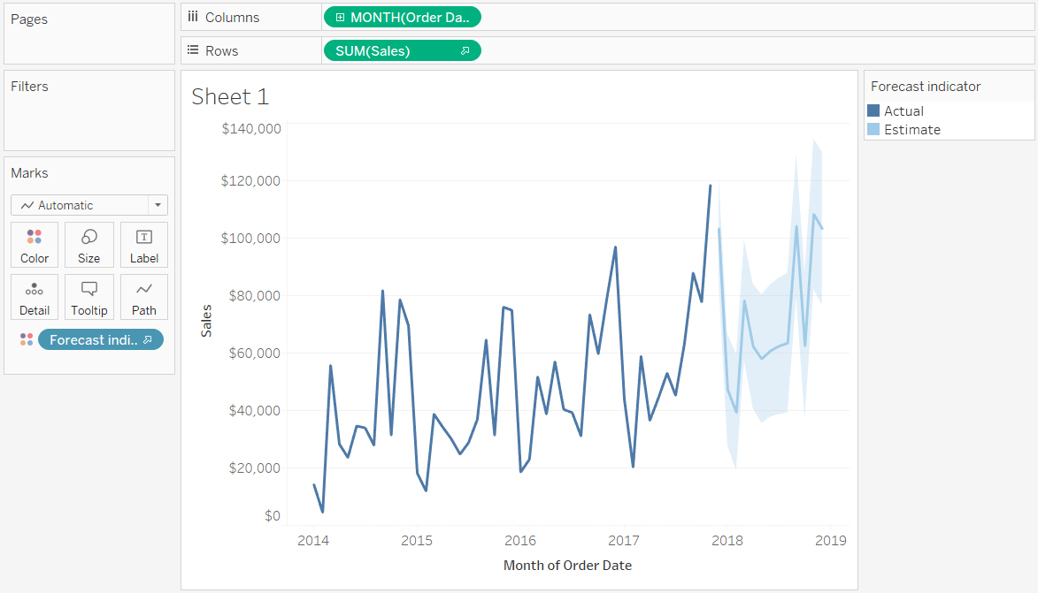
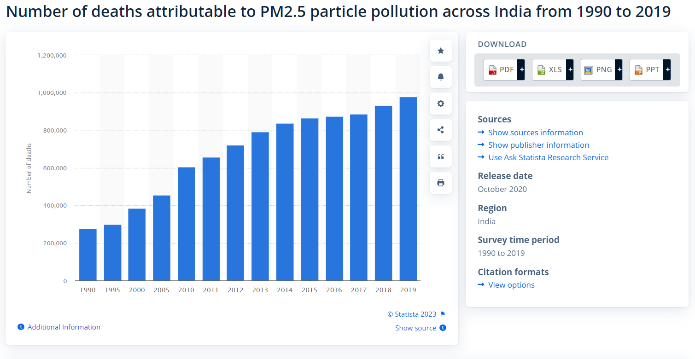
Understanding the Problem Statement
Air Quality Measure
Air quality measurement is crucial for assessing pollution, understanding impacts, and guiding effective control measures. The main pollutants that are commonly checked in air quality monitoring: PM_{2.5} , PM₁₀, SO₂, NO_{X}, CO, CO₂, NMVOC.
Why monitor PM_{2.5} ?
PM_{2.5} is most significant in air quality measures due to the hazards it poses -
Reasons
Due to its small size PM2.5 is able to penetrate deep into the human respiratory system .
Adverse health impacts of PM2.5.
PM_{2.5} contains a harmful composition of toxic compounds, posing health risks upon inhalation.
PM_{2.5} :POV India
PM_{2.5} Forecast
Average PM_{2.5} Concentration:
PM_{2.5}
Number of deaths attributable to PM_{2.5} particle pollution across India
The Solution!
Time
A real-time prediction tool can be used to create strategies for assessing and warning the public about anticipated harmful levels of air pollution.
The trained ML forecasting model can assist in controlling PM_{2.5} attributes by suggesting emission reduction strategies.
A significant increase in deaths due to PM2.5 over the years.
Steady increase in the levels of PM_{2.5} in the country between 1998-2020.

Slide 3
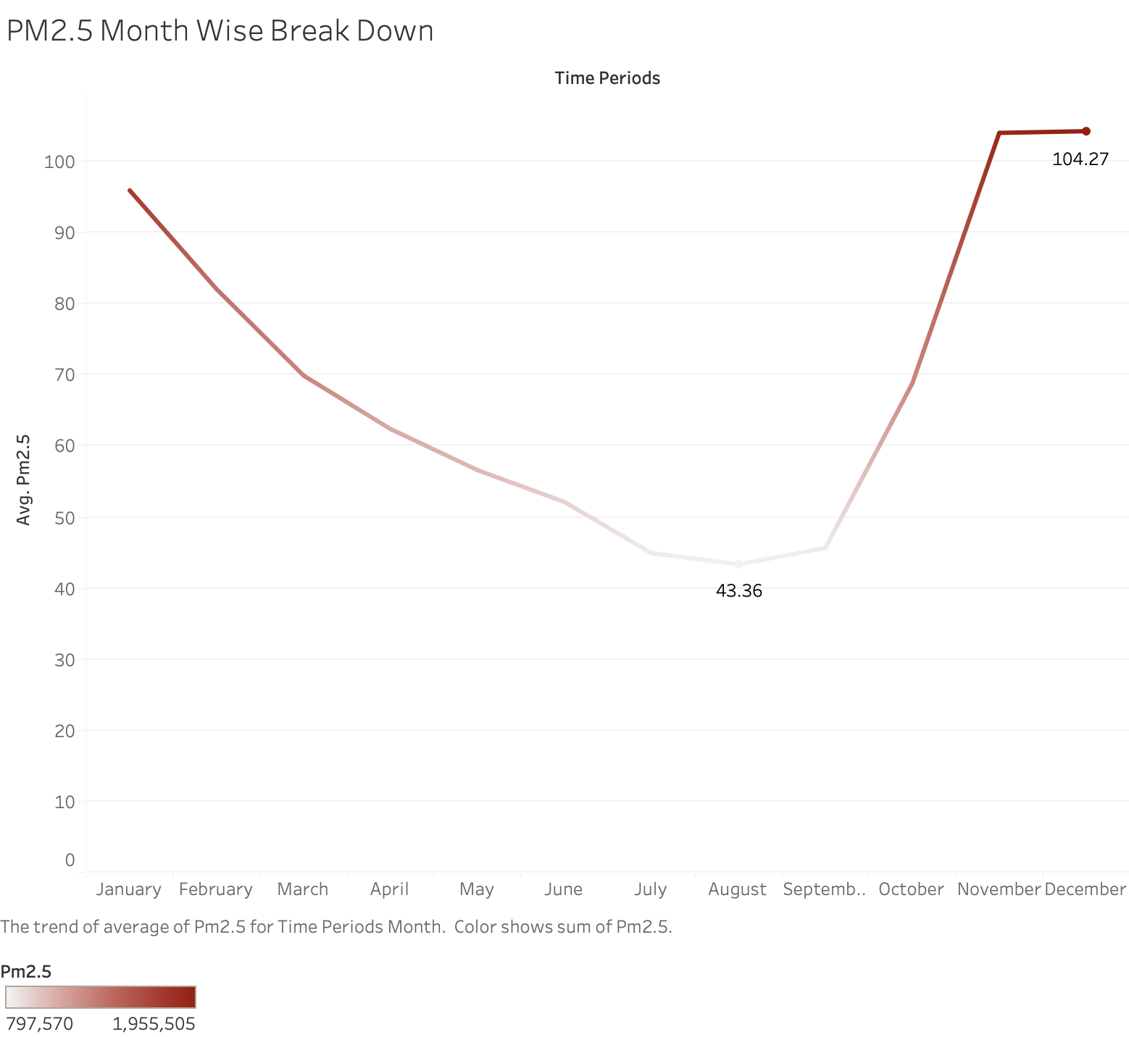
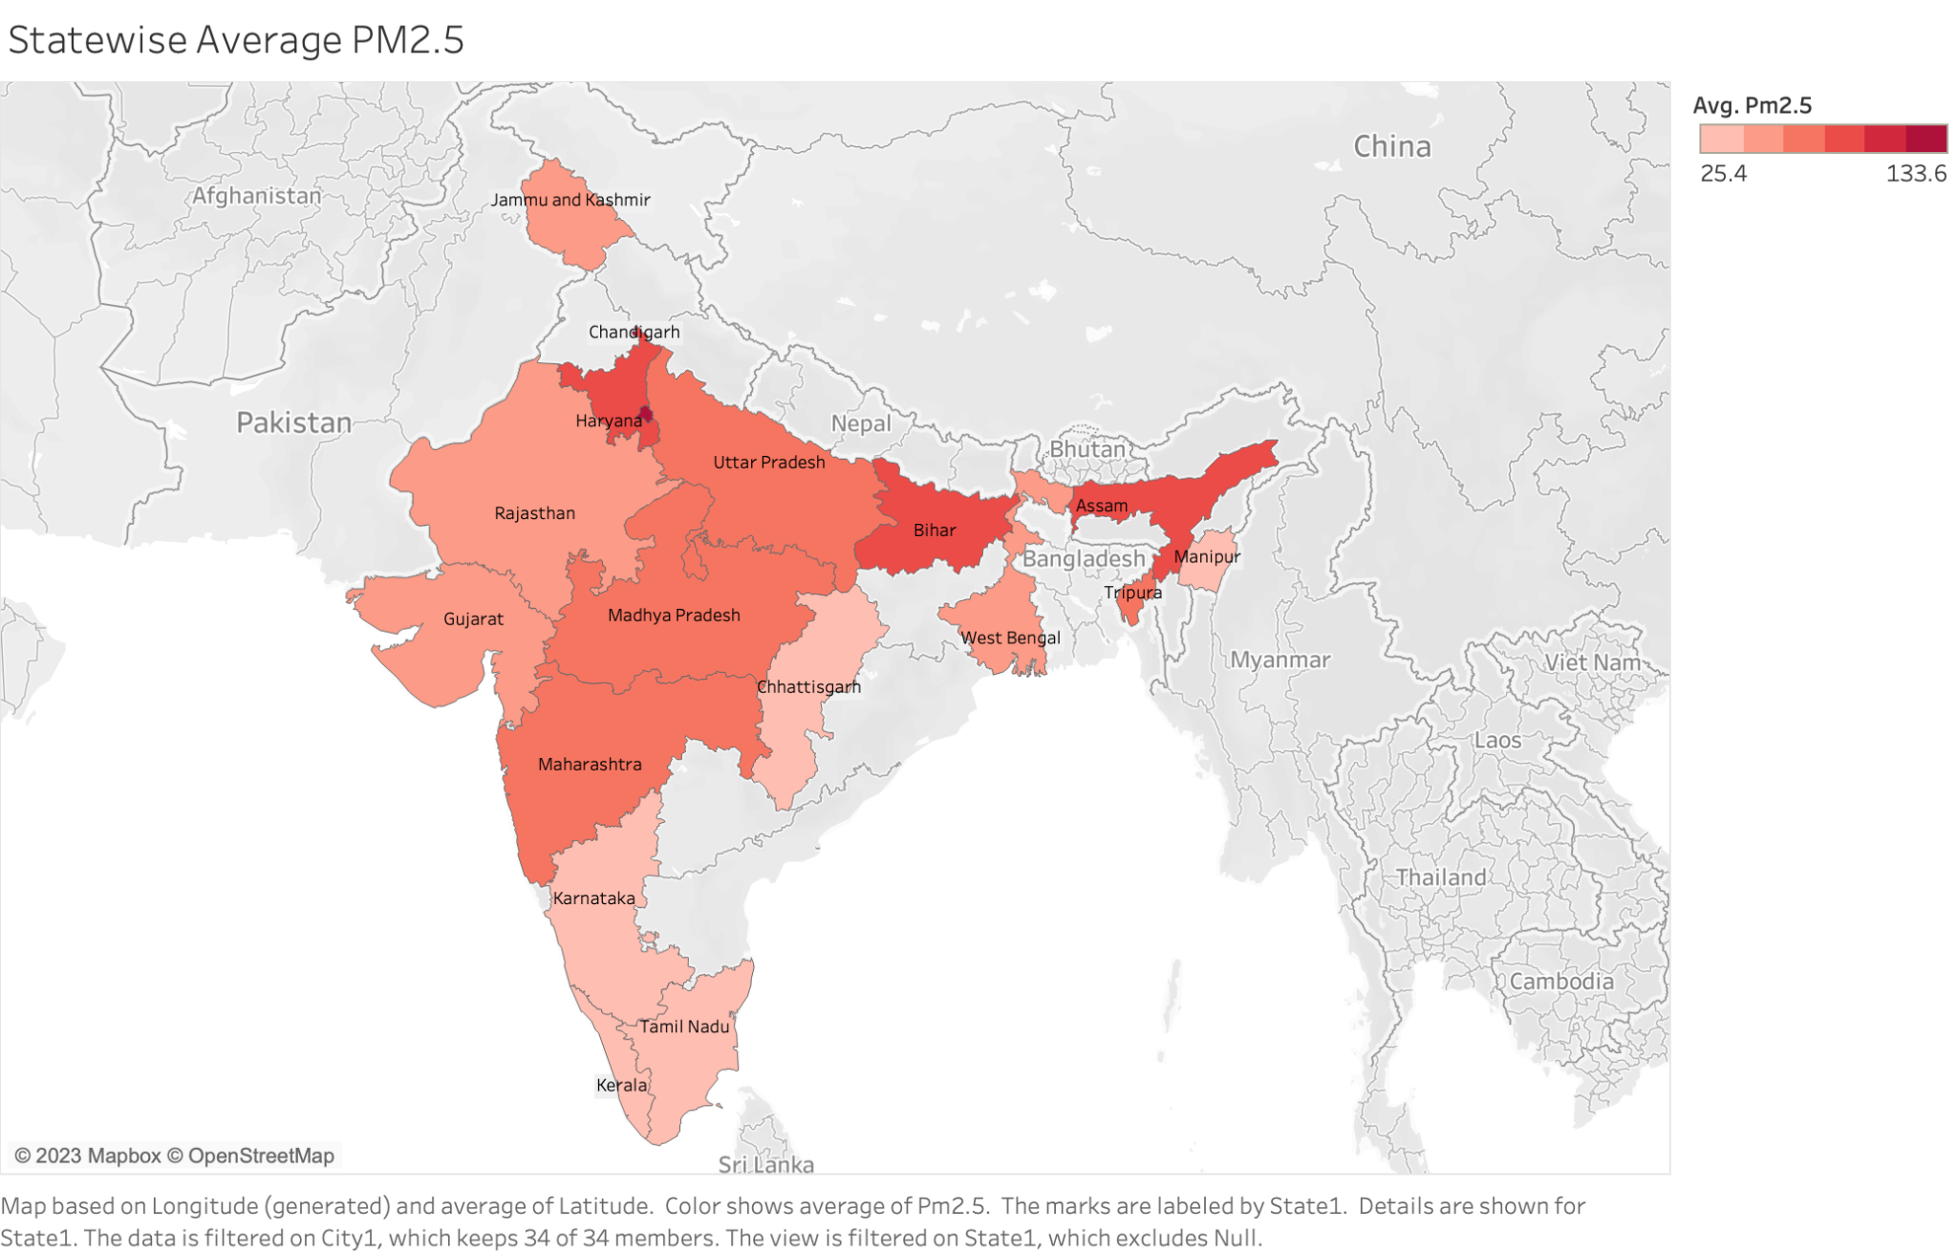
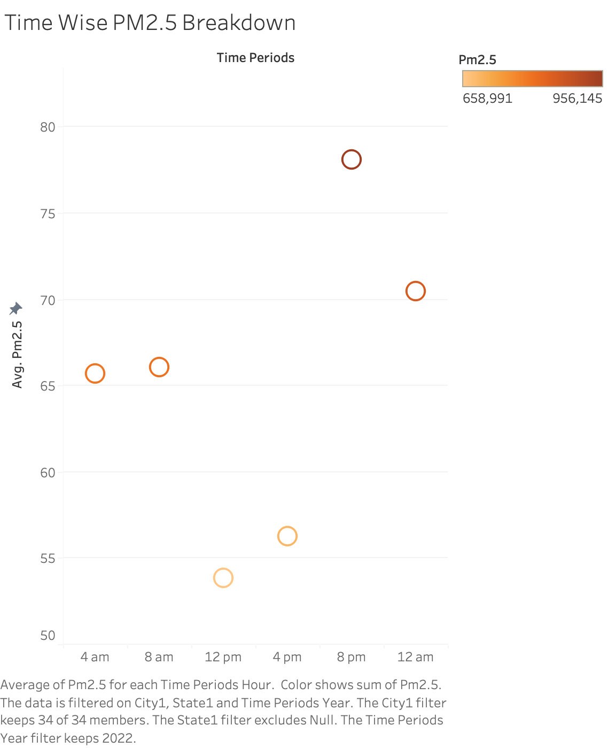
Identifying key findings/patterns in the data
Month Wise Avg. PM_{2.5} Break Down
The Dataset
Timeline: 3 years (Jan 2020 - Dec 2022) 4-hourly spaced in 24 hours.
Total Cities: 34
Total Attributes : 45
Types of Attributes : Meteorological, Demographic, Vehicular and Date.
State Wise Average PM_{2.5}
Peak PM_{2.5} levels in Indian cities during Nov, Dec, and Jan due to higher emissions (crop burning, festivals).
Decrease in PM_{2.5} from Jan to Aug due to better meteorological conditions (higher winds, improved pollutant dispersion).
Time-Wise Avg. PM_{2.5} Break Down
Higher PM_{2.5} emissions between 4pm-8pm is due to increased vehicular traffic, industrial activities, and evening cooking or heating.
Lower PM_{2.5} around noon as factories may have lunch breaks and traffic flow is typically less intense compared to rush hours.
Delhi, Haryana, Bihar and Assam have higher average PM _{2.5} concentration levels.
Karnataka, Tamil Nadu, Kerala and Manipur have lower average PM _{2.5} concentration levels.

Slide 4
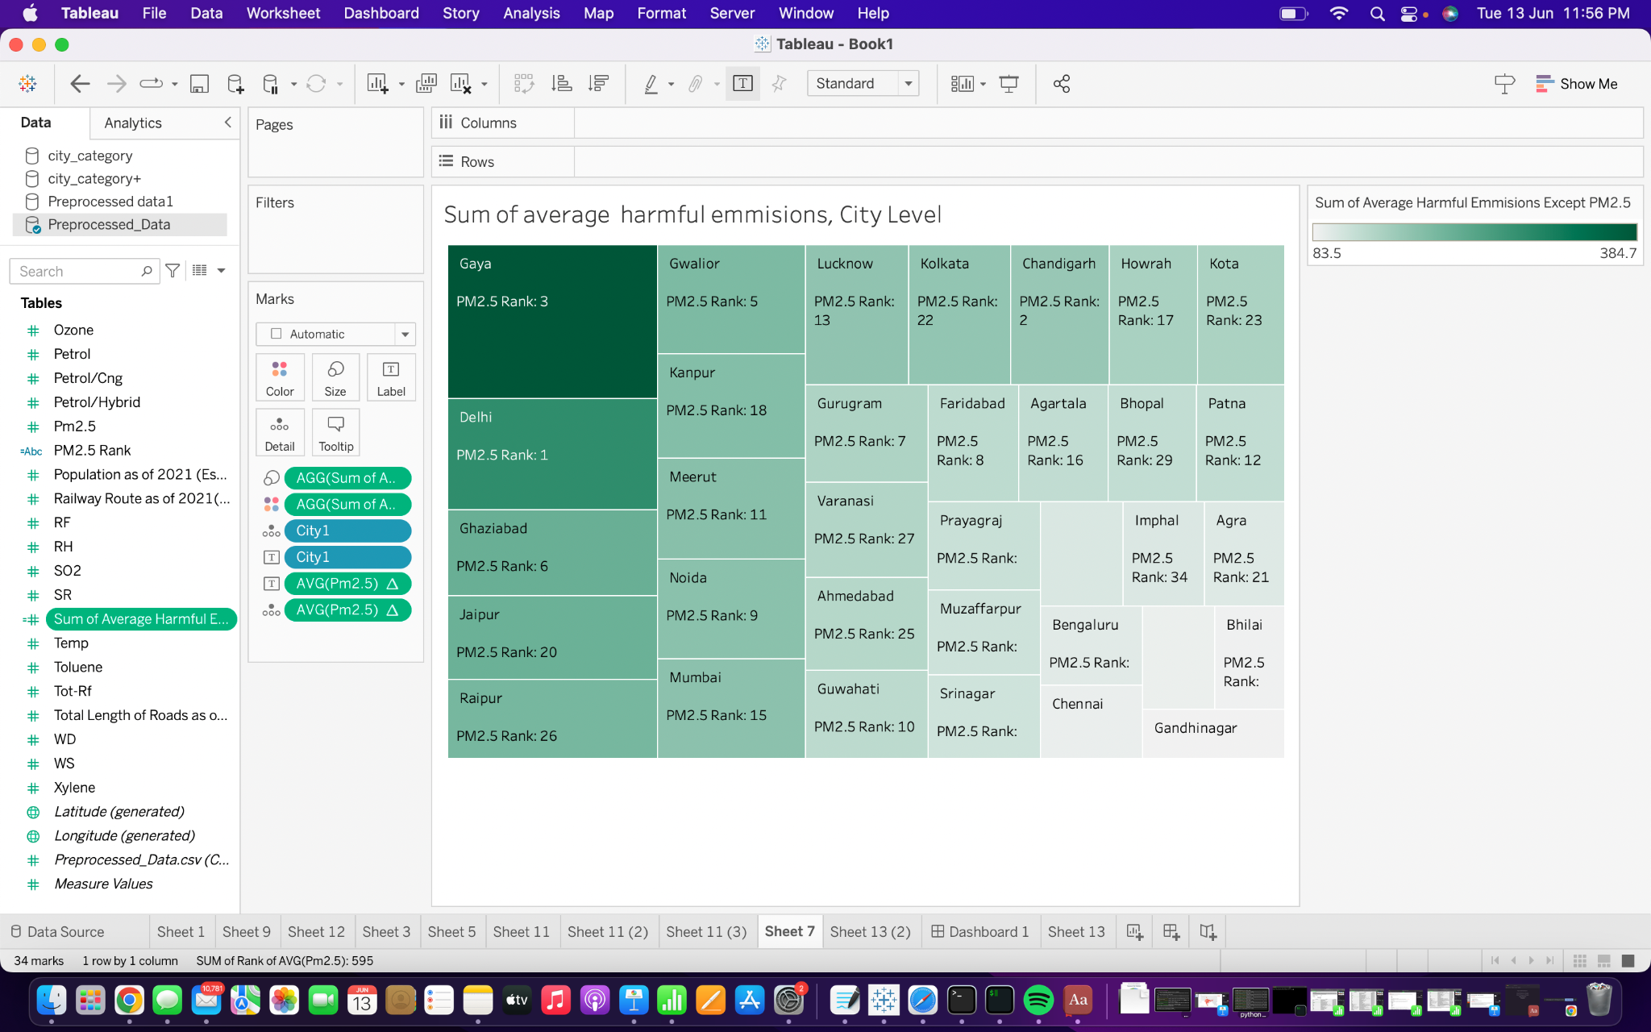
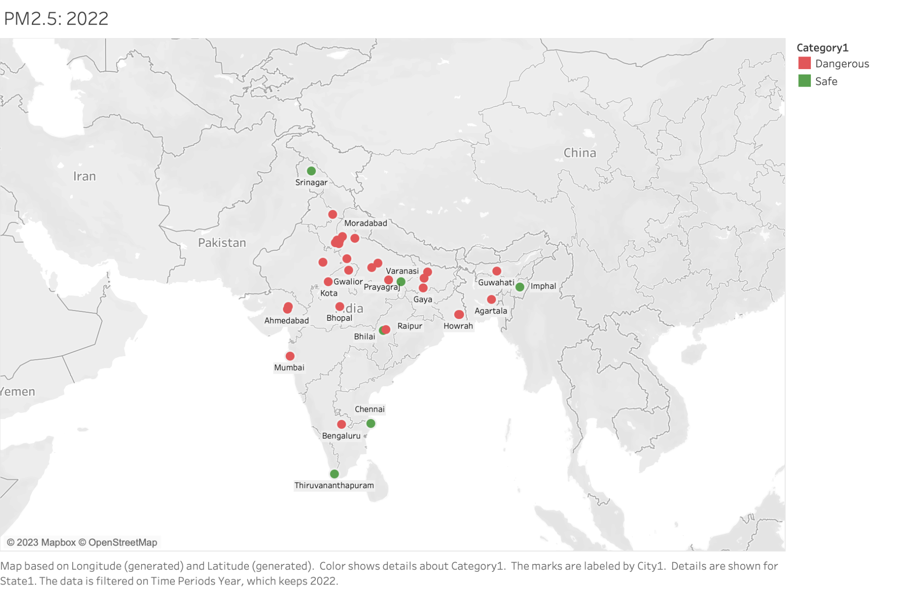
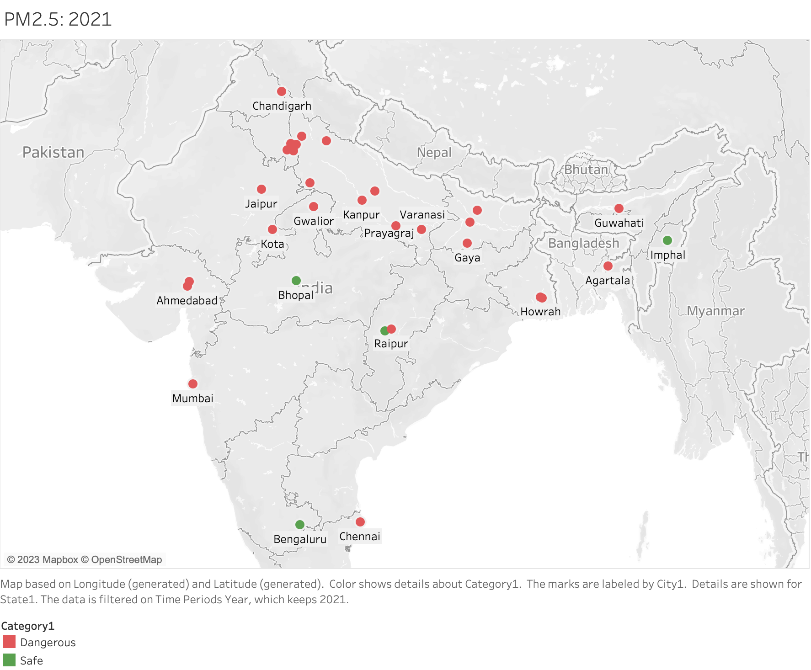
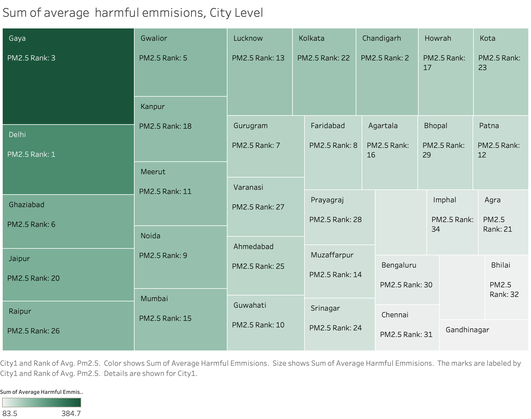
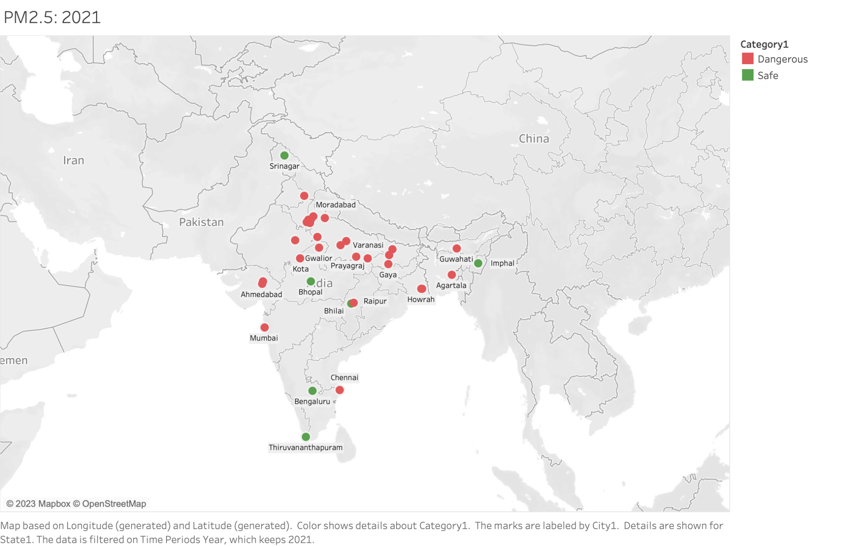
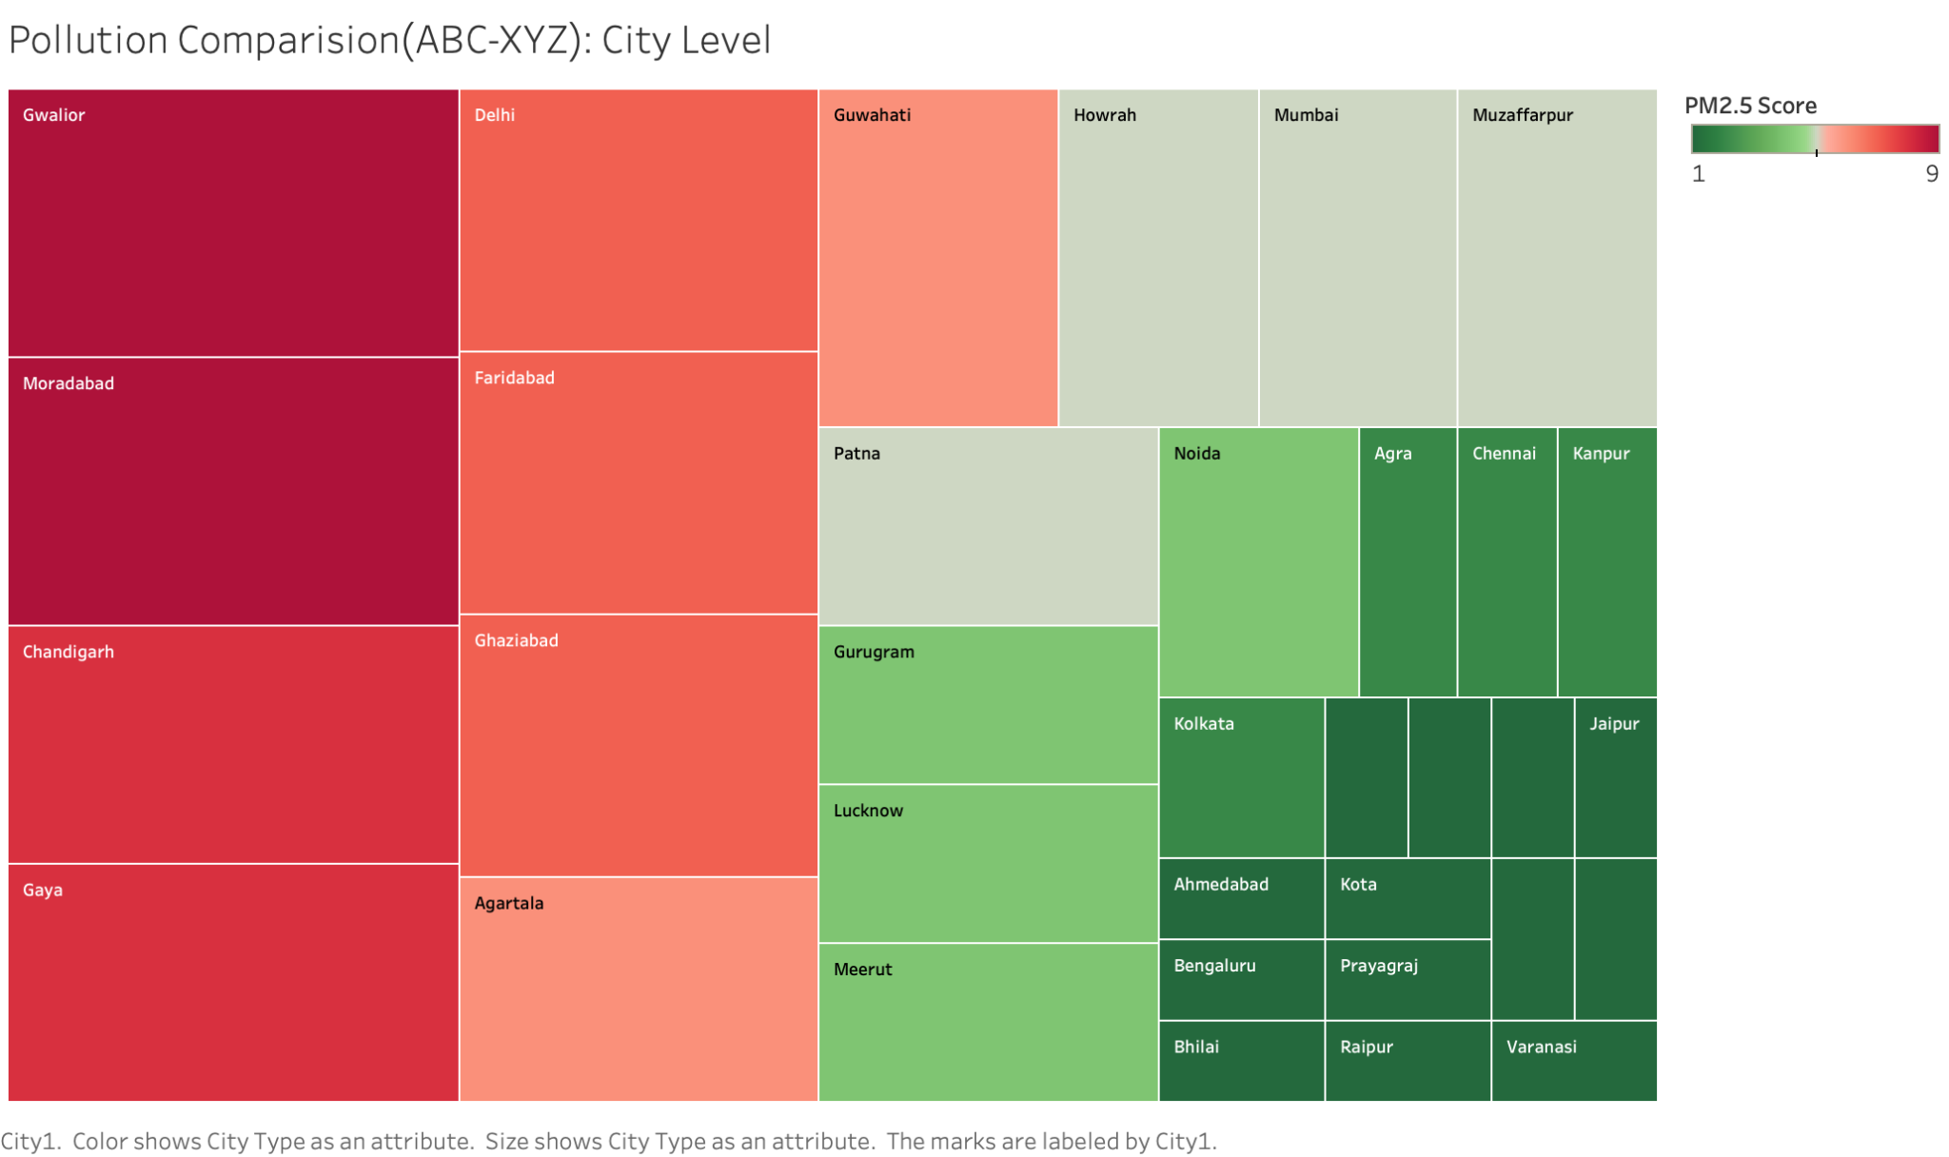
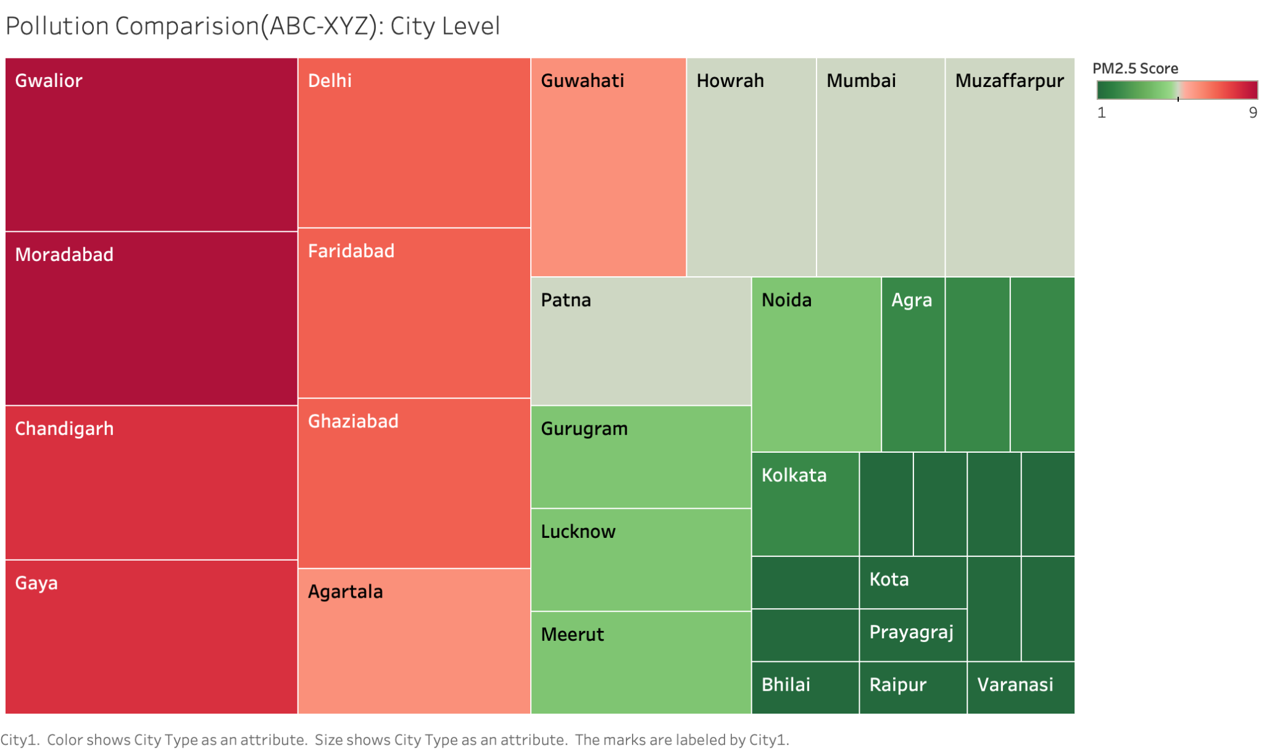
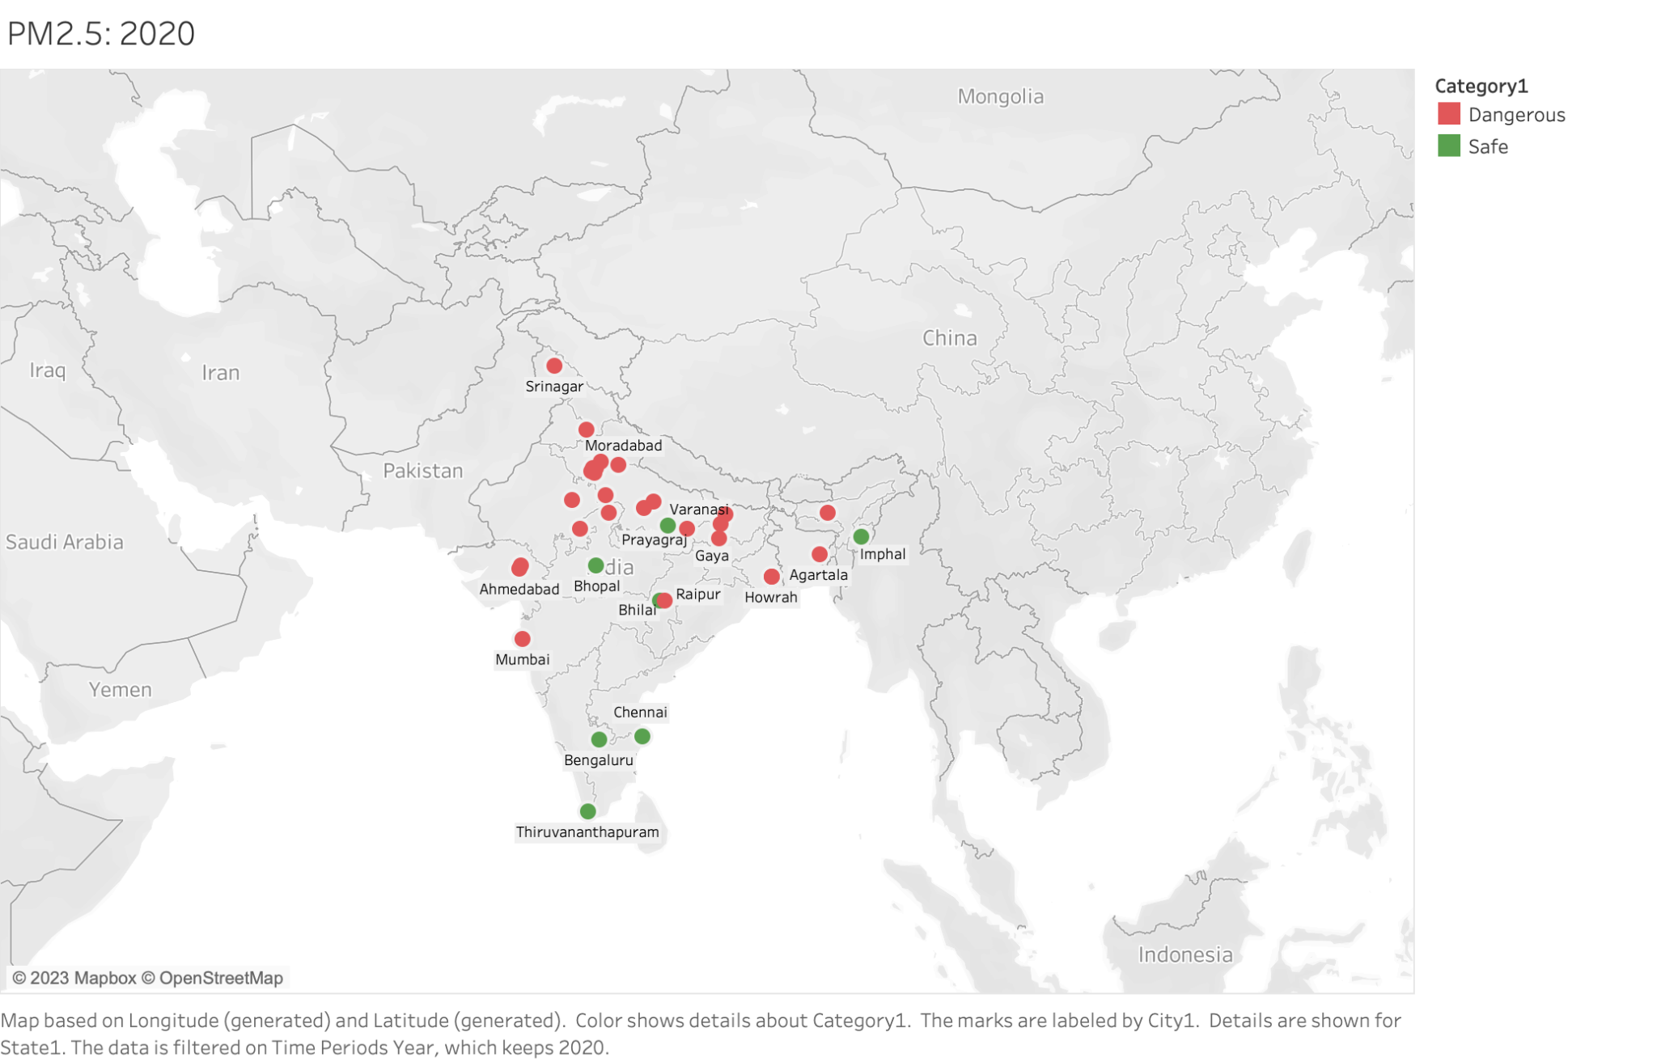
Identifying key findings/patterns in the data
Year Wise Average PM_{2.5} Analysis
Other harmful emissions: city wise comparison
(Benzene,CO,NH₃,NO,NO₂,NO_{x},Ozone,SO₂)
2022
Moradabad
PM2.5 Rank: 4
2021
PM_{2.5} Relative Comparison between cities
2020
Bangalore
Annual average standard used to classify cities into safe and dangerous = 40 μg/m³
Higher score = High and consistent PM2.5 levels = More dangerous pollution.
Lower score = Low and consistent PM2.5 levels = Safer air quality.

Slide 5
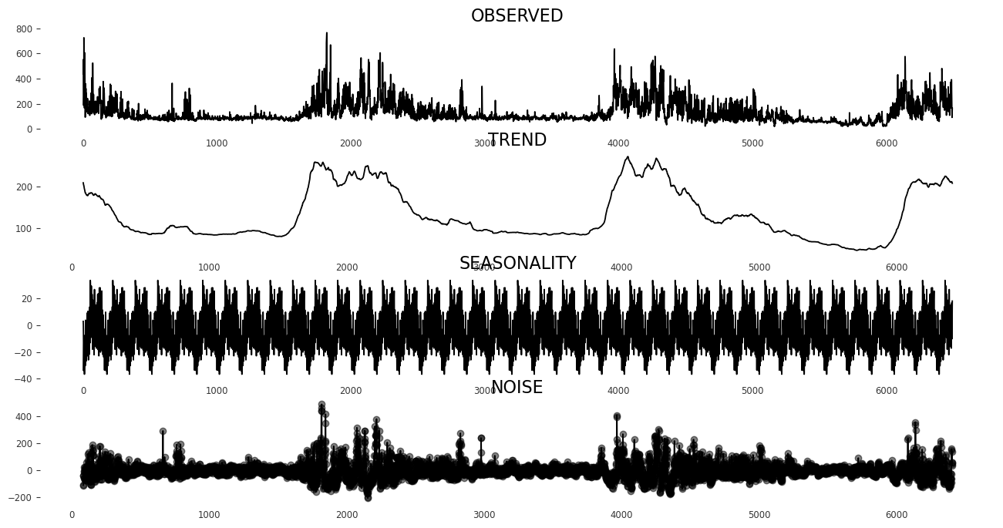
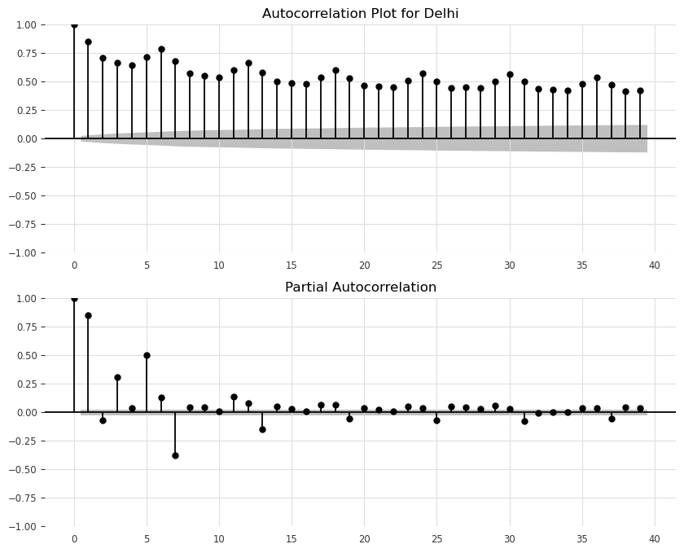
Summary of Modeling
Modeling Methodologies
Data Preprocessing
Time Series Methods
Machine Learning
Missing Data: Imputed using Time-based imputation, utilizing neighboring time points.
Anomaly: Highest percentage of missing data is for Volatile Organic Compounds (VOCs) like Benzene, Eth-Benzene, Toluene, etc.
Model Predictions (10% validation set)
Experimental Results: TIme Series Methods
Type | Method | Parameters | Avg. MAPE
Univariate | ARIMA | p = 1, d = 1, q = 1 | 0.60
Univeriate | SARIMAX | s = 12, p = 1, d = 1, q = 1 | 0.644
Univeriate | Simple Exponential Smoothing | Alpha = 0.05 | 0.589
Univeriate | Triple Exponential Smoothing | Alpha =0.01 , Beta = 0, Gamma = 0.05 | 0.580
Multivariate | VAR | Order = 1, Trend = None | >1
Time Series Analysis of PM_{2.5}
AD-Fuller Test:
Cities with Non Stationary PM_{2.5} : Moradabad, Agartala, Muzaffarpur, Srinagar, Raipur, Chandigarh
Seasonal Decomposition:
Experimental Results: Machine Learning Methods (+Time based FE)
Type | Method | Parameters | Avg. MAPE
Multivariate | Linear Regression | — | 0.665
Multivariate | Decision Tree | Criterion = MSE, Max_Depth = None | 0.663
Multivariate | Lasso Regression | Alpha = 1.0 | 0.620
Multivariate | Random Forest | Estimators = 100, Bootstrap = True | 0.579
Multivariate | LightGBM | Estimators = 100, Boosting type = gbdt | 0.570
Multivariate | XGBoost | Estimators = 100, Reg_lambda = 1.0 | 0.551
1.No trend 2. Seasonality of 28 days (1 Month Approx).
Autocorrelation Function & Partial Autocorrelation Function
RCA & Model Selection
Root Cause Analysis: The models gave the highest MAPE (worst forecast) on cities with PM_{2.5} of medium & high value, variability. (Eg, Chandigarh: AY, Gaya: AY, Faridabad: AZ, Howrah: BY).
Solution: - Complex model will be able to learn to predict a wider range of possible values. Regularization techniques can help to reduce the variance of the predictions
Model Selection: XGBoost, incorporates these features.
Hence we go with XGBoost as our final model!
Segmenting cities using ABC-XYZ Analysis:
A: High Value (>80 percentile) X: Low Variability (<=50 percentile)
B: Mid Value ((50-80] percentile) Y: Mid Variability (50-80] percentile)
C: Low Value (<=50 percentile) Z: High Variability (>80 percentile)

Slide 6
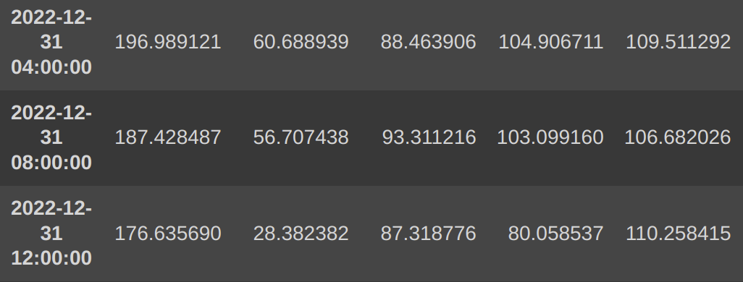
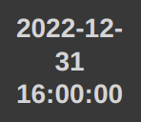
Solution Design
Evaluation of strengths and weaknesses of the model & overall framework
Our recursive ML with sliding window technique (demonstrated for a small subset of dataset):
PM_{2.5}
NO
NO₂
NOx
PM_{2.5}
PM_{2.5 (t-1)}
NO_{(t-1)}
NO_{2 (t-1)}
NOx_{(t-1)}
Used Lagsize = 1
…
…
…
…
…
Drop
Forecast PM2.5 for the next time step based on the previous step using the ML model.
Append the forecasted value to training data and predict PM2.5 for the subsequent time step.
Repeat this process recursively to forecast for the desired 3-day time frame.
…
Train
XGBoost
To be Forecasted
Inference
Restructure the dataset into supervised learning problem
y
X
Shapely Additive Explanations (SHAP)
We utilize SHAP values to recommend PM2.5 reduction and control measures based on feature importance from the trained model.
ML Explainability
Strengths:
The Recursive model is robust to any data distribution (e.g., non stationary data). Great for forecasting when dealing with unpredictable data.
In terms of explainability, XGBoost is better than many classical time series methods which are based on statistical approach.
Though XGBoost is a black box model, it can still be explained using tools like SHAP values.
Weakness:
Our recursive framework is sensitive to errors in the initial forecast. These errors will be propagated forward in the model, leading to inaccurate overall forecasts.
The model is computationally expensive to train, especially for large datasets.
Improvements:
Moving forward, we aim to optimize our ML model by focusing on two key techniques: Slicing and Aggregation - Enhancing forecasting accuracy by reducing data noise and aggregation will also minimize time overheads.
We can improve modelling upon intermittent data (data with high freq of 0 PM_{2.5}).

Slide 7
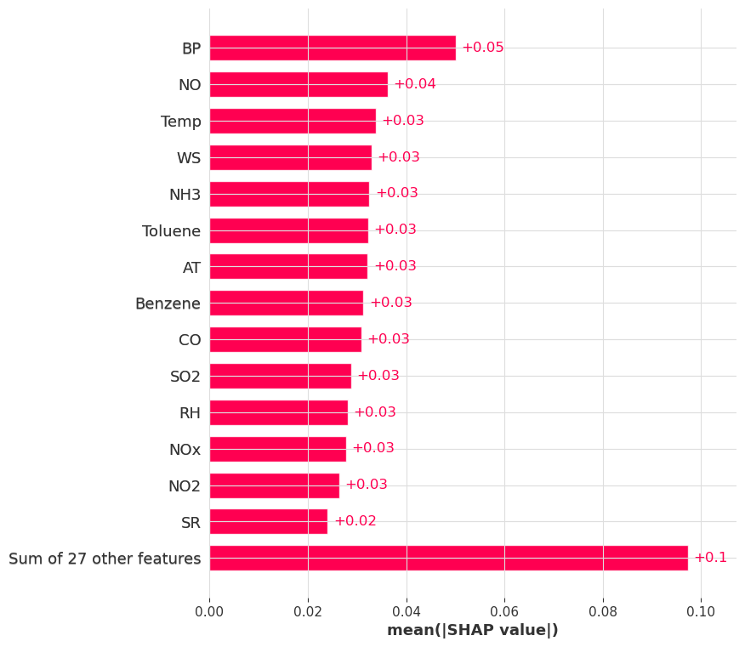
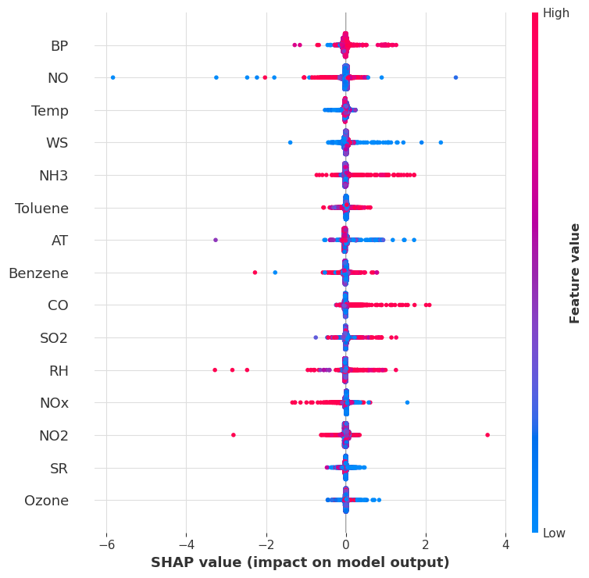
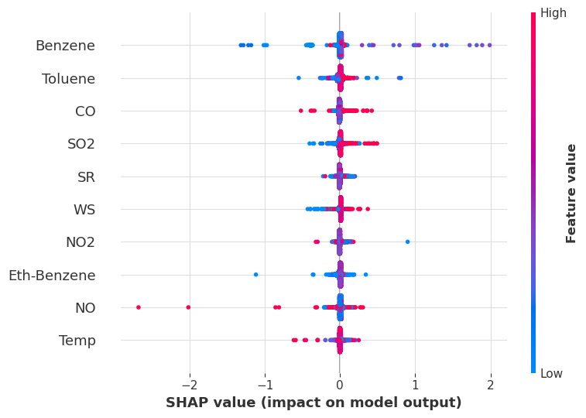
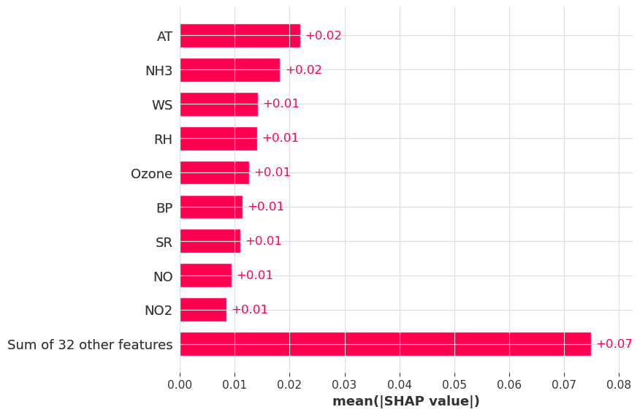
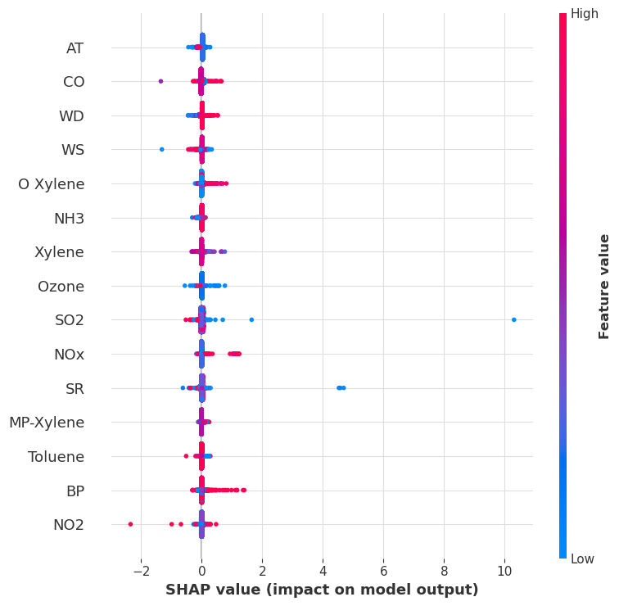
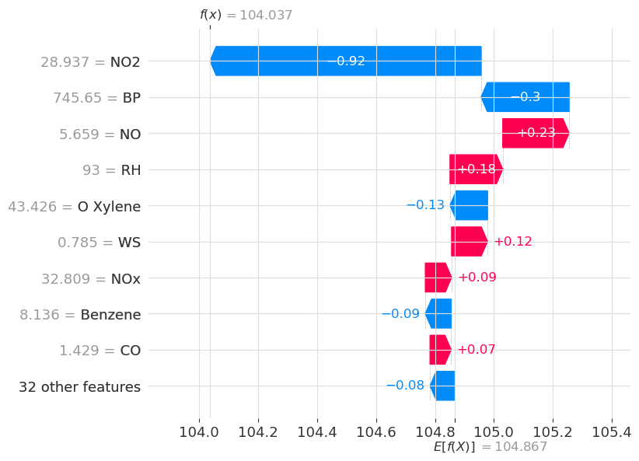
Recommendations
We use SHAP values to examine how each attribute in the data impacts PM_{2.5} for different cities. Based on which we make recommendations for PM2.5 control.
Note: We receive the highest SHAP values for the previous time step PM_{2.5} (previous 4 hours). We have omitted it for making recommendations.
Delhi: Highest Average PM2.5
Other high PM2.5 cities
Chandigarh: 2nd highest Avg PM_{2.5}
Meteorological factors (Barometric pressure, wind speeds, and temperature) have the greatest influence on PM2.5 in Delhi, followed by emissions like NO, CO, NH3, and VOC compounds.
Stubble burning in Punjab and Haryana significantly increases NH3, CO, SO2, and VOCs, impacting PM2.5 levels in Delhi which can be reduced using baling or composting can help control PM2.5.
Gwalior: Highest (Relative PM_{2.5} + Consistency)
Moradabad: Highest (Relative PM_{2.5} + Consistency)
Final Recommendations
Analyzing SHAP scores of meteorological variables in highly polluted cities helps identify favorable PM2.5 formation conditions, enabling targeted mitigation efforts.
Examining SHAP scores of other pollutants across cities reveals their chemical behavior and contribution to PM2.5.
Cleaner fuels along with selective Catalytic Reduction in vehicles and factories can reduce these emissions.
Impact during highest PM2.5 emission
CO, NO_{x}, Xylene, O-Xylene, and NH₃ are major driving factors of PM_{2.5} in Moradabad. Moradabad is located in the Indo-Gangetic Plain surrounded by mountains, which traps the pollutants that leads to their consistent levels.
Measures like cleaner production technologies in refineries, pollutant traps in vehicles can help control these emissions.

Slide 8
Thank You
Any Questions?

